Slide 1
R & Python applied models
Kandis Lamke
Ruben Garcia
April 3, 2020

Slide 2
Agenda
Introductions
Industry Insights
Overview
Key Objectives
Used technologies & Method
R programming
Python programming
Project Results
Analysis
Key findings
Conclusions
Next steps
Q&A
Notes:
Outline Agenda

Slide 3
introductions

Slide 4
Professional profile
Professional Experience
Chief Operating Officer
Controller
Accounting Manager
Entrepreneur
Education
Bachelor of Arts – Accounting Major
Licensed CPA
Kandis
Lamke

Slide 5
Professional profile
Professional Experience
OpEx programs implementation across Global Operations
Lean transformation throughout the Supply Chain
Centers of Excellence implementation
Lead Supplier Development programs
Education
MBA – Global Management
BS – Industrial Engineering
Lean Six Sigma Black Belt
Certified OCM professional
Certified SCM professional
Ruben
Garcia

Slide 6
Industry insights

Slide 7


overview
Industry:
PEO - Professional Employer Organization
Definitions:
WSE – Worksite Employee
Internal EEs – Internal employees of the PEO that support clients and WSEs
Notes:
Project Summary – Domain Knowledge and Insight into the PEO Industry and standard benchmarks, etc

Slide 8
overview
Professional employer organizations (PEOs) provide comprehensive HR solutions for small businesses from payroll, benefits, HR, tax administration, and regulatory compliance assistance
PEOs help businesses improve productivity, increase profitability, and focus on their core mission while ​taking care of paperwork and providing regulatory compliance assistance
​Through a PEO, the employees of small businesses gain access to big-business employee benefits such as: 401(k)plans; health, dental, life, insurance, and other benefits they might not typically receive as employees of a small company
Notes:
Languages and methods used in the analysis

Slide 9
Project objectives
Identify Gross Profit (GP) per WSE performance vs benchmarking
Define improvement opportunities
Identify WSE to internal EE performance vs benchmarking
Define improvement opportunities
Create a statistical model to predict number of internal EEs needed by department to reach GP or WSE goals
Create a model to predict when the Company will reach GP or WSE goals
Notes:
Languages and methods used in the analysis

Slide 10
technologies APPLIED and
Results achieved

Slide 11
programming
R is a language and environment for statistical computing and graphics
It helps with data manipulation, calculation and graphical display
Effective in data handling, statistical analysis, conditionals, loops, and user-defined functions
Its capabilities are extended through user-created packages, which allow specialized statistical techniques, graphical devices, import/export capabilities, and reporting tools
Notes:
Languages and methods used in the analysis

Slide 12
analysis
Objective:
Determine the annual GP by active WSE and compare that to industry benchmarks
The annual gross profit by active WSE in 2019 was $1,285 – nearly 20% below the benchmark of $1,595

Slide 13
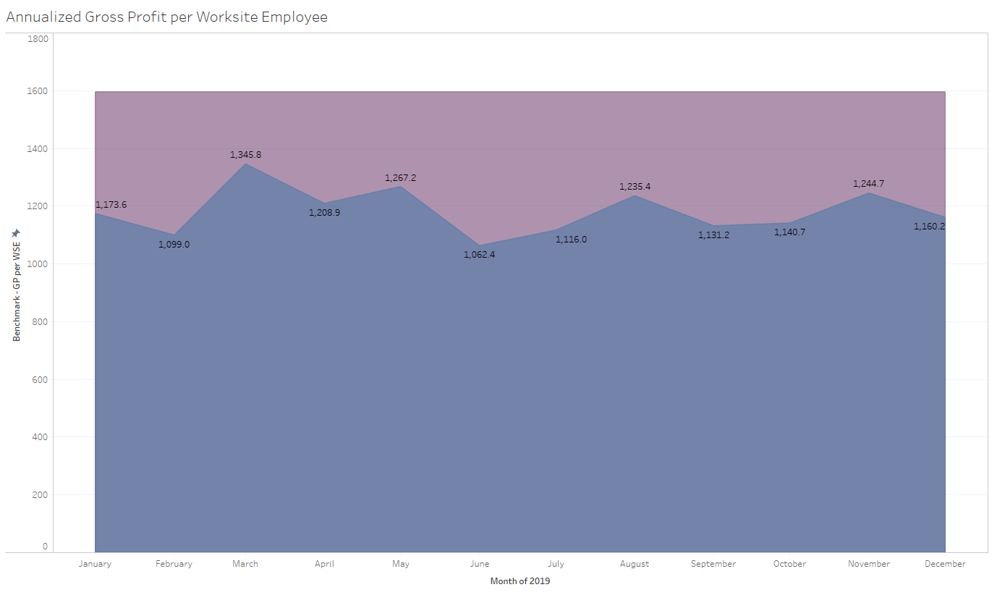
Project results

Slide 14
Identify WS_INT_EE_Ratio_S performance vs benchmarking
Used One Sample t- test where we compared the mean of our population to the benchmark value
Original hypothesis
M_population = M_benchmark
Rejected original hypothesis
Company performance is better than benchmark
Rejected original hypothesis
Company performance is better than benchmark

Slide 15
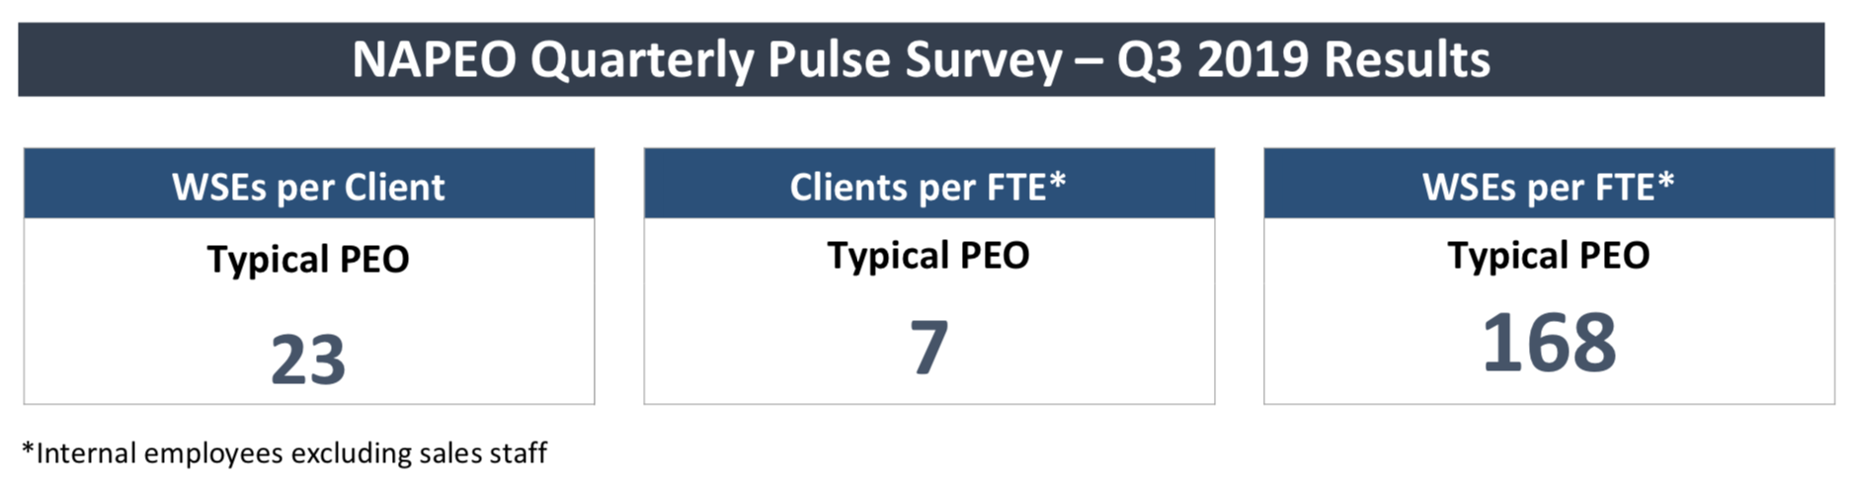
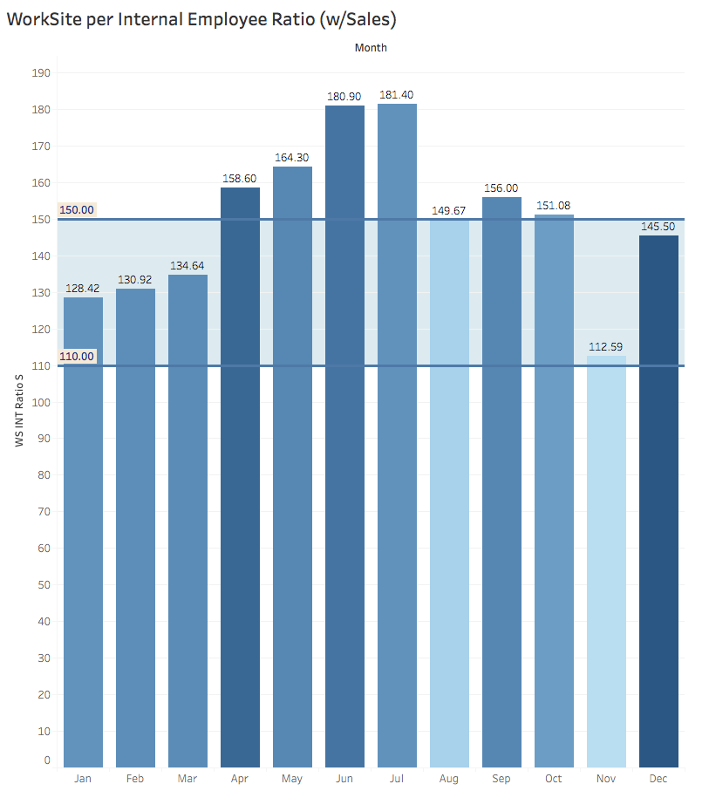
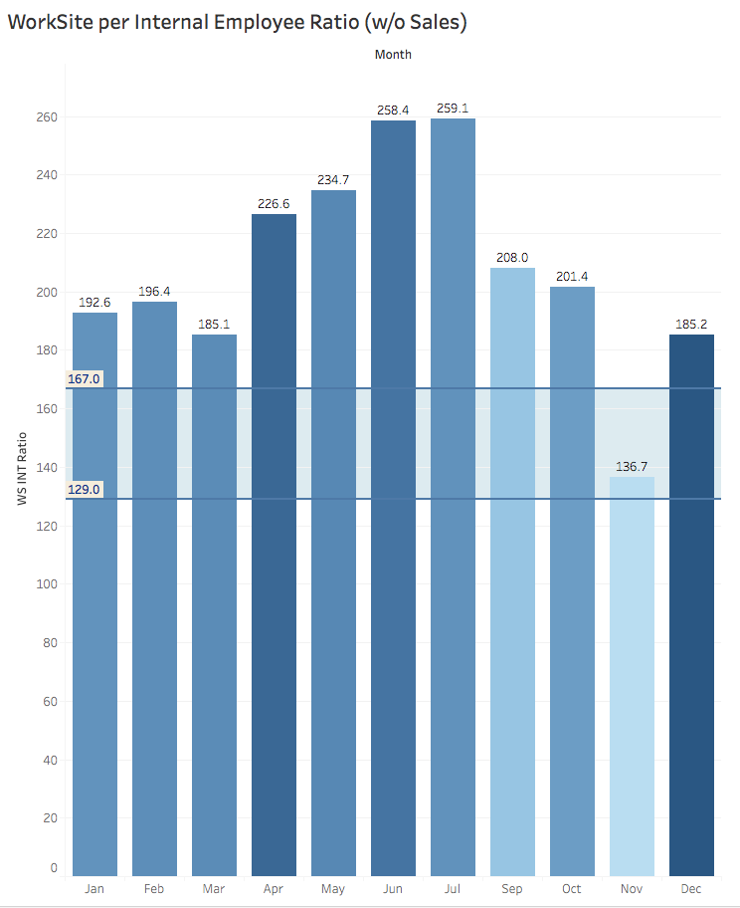
Project results

Slide 16

programming
Python is an object-oriented, high-level programming language, primarily for web and app development
It is relatively simple, so it's easy to learn since it requires a unique syntax that focuses on readability
It allows teams to work collaboratively without significant language and experience barriers
It supports the use of modules and packages where code can be reused across a variety of projects
It is scalable for use in other projects, and its modules are easy to import or export
Notes:
Languages and methods used in the analysis

Slide 17
analysis
Objective:
Predict when the company will reach either revenue goals or worksite employee goals based on prior year growth trends.
At the current GP per WSE trends, the PEO will need to reach 5,000 WSEs to reach a $5m GP
Number of active WSE’s only accounts for 80% of the variability in GP

Slide 18
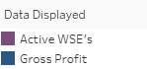
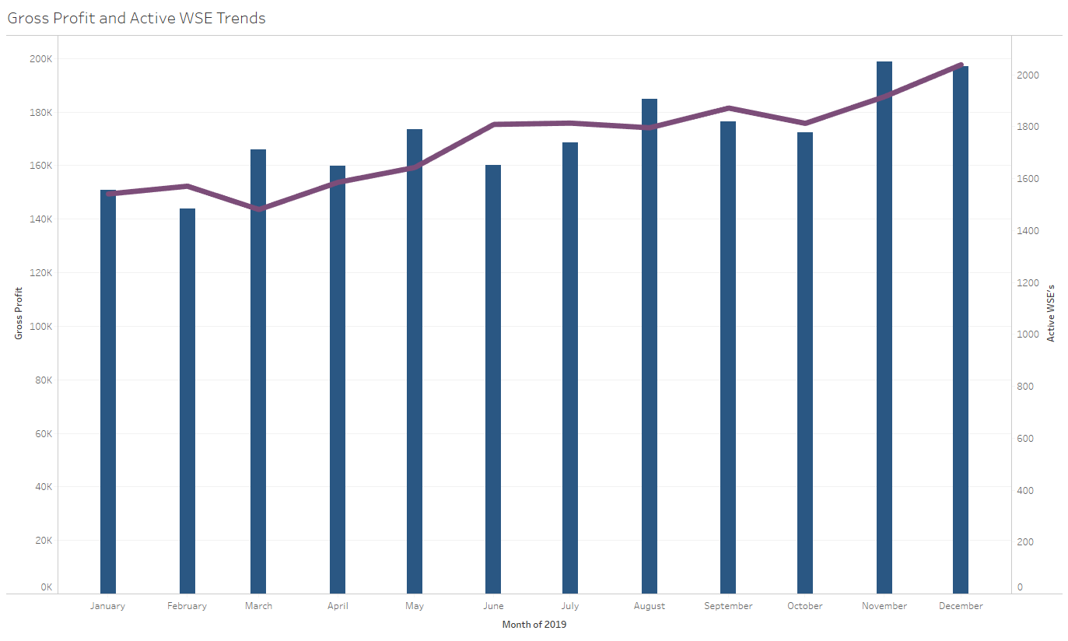
Project results

Slide 19
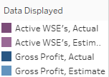
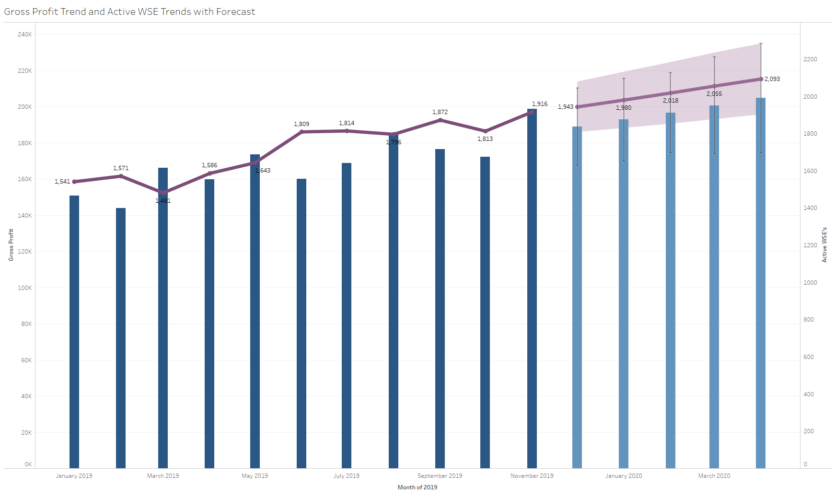
Project results

Slide 20
Create a model to predict number of INT_EE needed by Department to reach WS_EE goals
Used Linear regression model to help us predict what combination of INT_EE will give us a better ratio
Generated over 1,000 random combinations of INT_EE values vs benchmark ratio
Current INT_EE

Slide 21
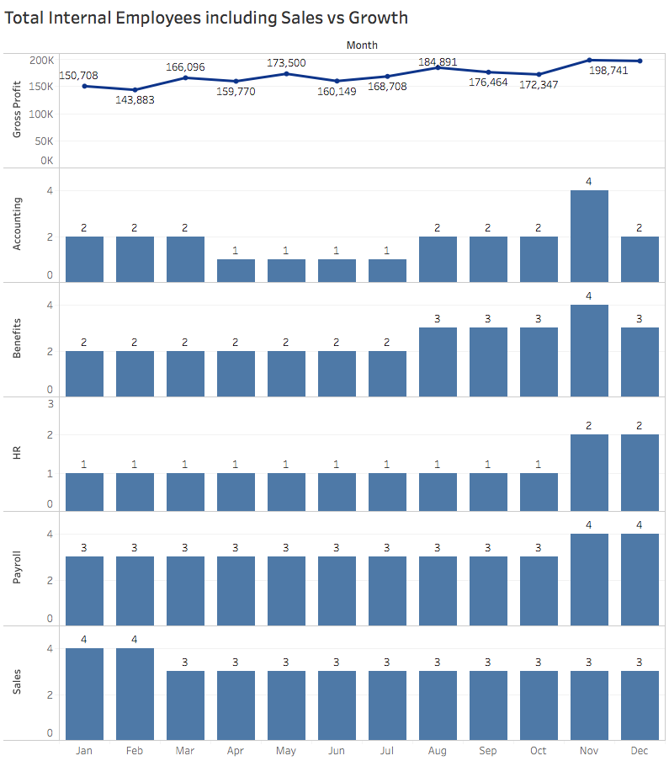
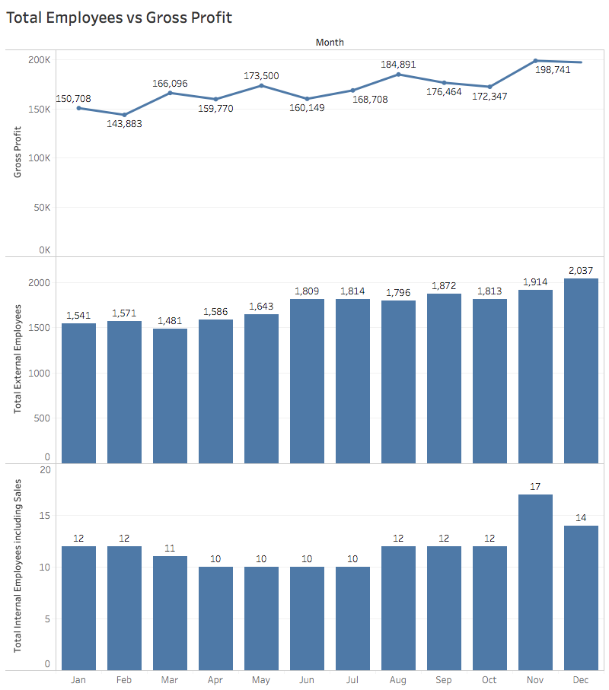
Project results

Slide 22
summary
The WSE to internal EE ratio (with Sales) performance is 36% better than benchmark companies - 150 vs 110
The WSE to internal EE ratio (without Sales) performance is 60% better than benchmark companies - 207 vs 129
The annual GP by active WSE is $1,285 – nearly 20% below the benchmark of $1,595
Number of active WSE’s only accounts for 80% of the variability in GP

Slide 23
conclusions

Slide 24
Conclusions

Slide 25
Next steps

Slide 26
next steps

Slide 27
QUESTIONS?

Slide 28
overview
PEOs provide access to cost-effective training and development
50% of business using PEOs are less likely to fail
30% time relieved by SMB leadership due to administrative and transactional issues
68% PEOs saw somewhat or significant revenue increase
35% PEOs saw a significant increase in WS_EE per client
56% PEOs saw somewhat or significant gross profit increase
28% PEOs saw somewhat or significant INT_EE (including Sales) increase
48% PEOs saw somewhat or significant Clients increase
85% PEOs see somewhat or significant WSEs change over the next 12 months
Notes:
Languages and methods used in the analysis

Slide 29
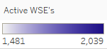
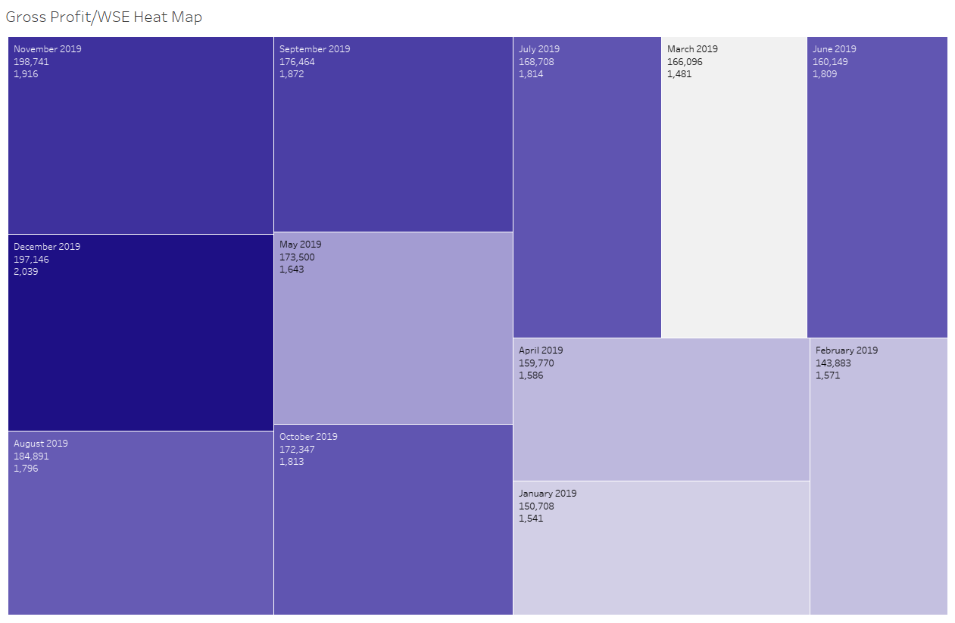
Project results

Slide 30
